Slide 1
Wifi Remote Control Car with Crash Detection.
By: Luis Garcia,
Frank Castillo,
Anwar Ibrahim,
Jesus Arcos

Slide 2
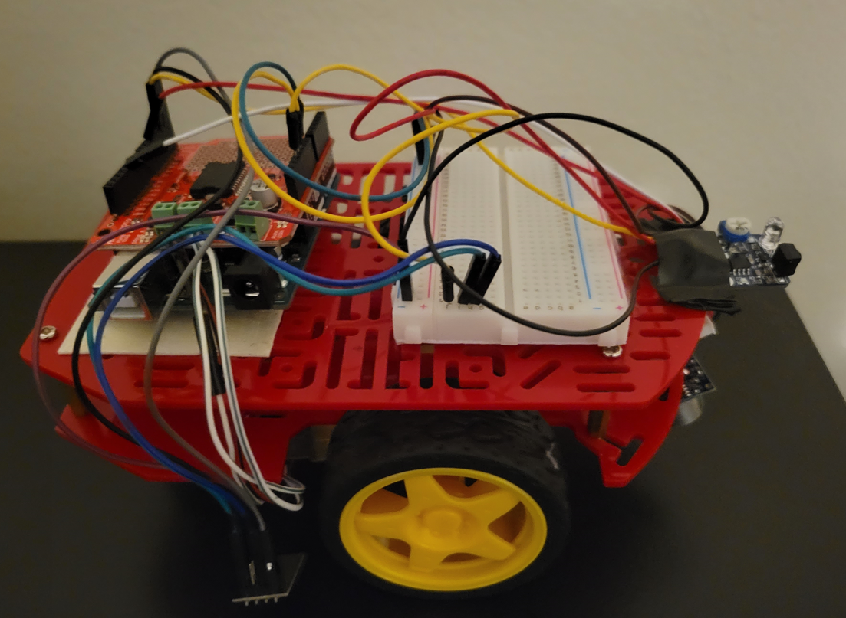
Components
Arduino UNO Board
Motor Shield
2x Motor/Wheel
Esp8266
Ultrasonic Sensor
IR Obstacle Sensor
Portable Charger
2x Baseplate
Bread Board
Dupont Wire
Mobile Phone
ADD IMAGE OF CAR

Slide 3
RemoteXY app
// RemoteXY select connection mode and include library
#define REMOTEXY_MODE__ESP8266_HARDSERIAL_POINT
#include <RemoteXY.h>
#include <NewPing.h>
// RemoteXY connection settings
#define REMOTEXY_SERIAL Serial
#define REMOTEXY_SERIAL_SPEED 115200
#define REMOTEXY_WIFI_SSID "RemoteXY"
#define REMOTEXY_WIFI_PASSWORD "12345678"
#define REMOTEXY_SERVER_PORT 6377
// this structure defines all the variables and events of your control interface
struct {
// input variables
uint8_t forward; // =1 if button pressed, else =0
uint8_t left; // =1 if button pressed, else =0
uint8_t backward; // =1 if button pressed, else =0
uint8_t right; // =1 if button pressed, else =0
uint8_t Stop; // =1 if button pressed, else =0
uint8_t speedDown; // =1 if button pressed, else =0
uint8_t speedUp; // =1 if button pressed, else =0
// other variable
uint8_t connect_flag; // =1 if wire connected, else =0
} RemoteXY;
#pragma pack(pop)
The code to setup the remotexy app by having the ssid and password set of the esp8266. The struct sets up all our buttons as well and where they will be position in the app.

Slide 4
Motor and Sensor pins and values
//Define motor/sensor pins,
// DC Motor Shiled
#define Dir_A_Pin 8 //default_pin2
#define PWM_A_Pin 9//default_PWM3
#define Dir_B_Pin 4//default
#define PWM_B_Pin 11//default
const bool forward = HIGH;
const bool backward = LOW;
float speedA = 200;
float speedB = 200 ;
float speedBL = 0.60; // to change speed B TO 60% of speed A
float speedAR = 0.60; // to change speed A TO 60% of speed B
int dir = 0; //Will be used to determine direction of car
// One ultrasonic sensor
#define BTRIGGER_PIN 10 // Arduino pin tied to trigger pin, Botttom sensor
#define B_ECHO_PIN 5// Echo pin for Bottom Ultrasonic sensor
#define MAX_DISTANCE 400//max distance 9in centimeters
const int interrupt_pin =2; //For obstacle sensor
NewPing B_sonar(BTRIGGER_PIN, B_ECHO_PIN, MAX_DISTANCE);
We will have an IR obstacle sensor using hardware interrupt and one ultrasonic sensor in which will detect if there is a step so the car does not fall. The motor pins, directions, and default speeds are also set.

Slide 5
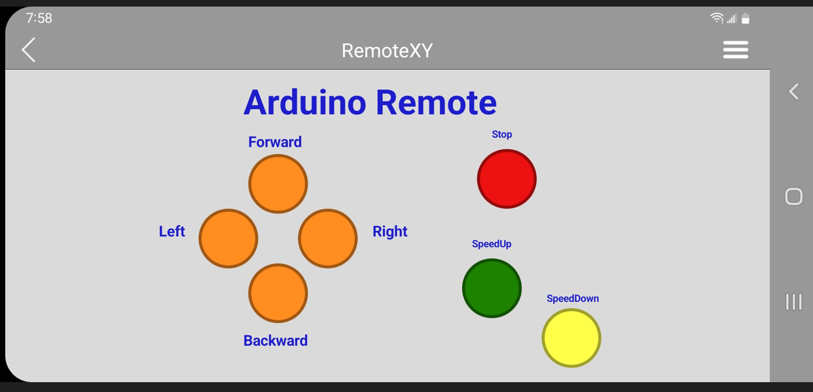
Controls
RemoteXY_Handler ();
if(RemoteXY.forward == 1) //RemoteXY.joystick_1_x > 0 &
{
goStraight(forward, speedA);
dir = 1;
}
if(RemoteXY.backward == 1) // RemoteXY.joystick_1_x < 0 &
{
goBackward(backward, speedA);
dir = 2;
}
if(RemoteXY.right == 1)
{
turnR(forward, speedA, speedB);
dir = 3;
}
if(RemoteXY.left == 1)
{
turnL(forward, speedA, speedB);
dir = 4;
}
if(RemoteXY.Stop == 1)
{
stopCar();
dir = 0;
}
if(RemoteXY.speedUp == 1)
{
speedUp();
//RemoteXY.speedUp = 0;
}
if(RemoteXY.speedDown == 1)
{
speedDown();
//RemoteXY.speedDown = 0;
}
Uses remotexy structure to determine which buttons are pressed and call the correct motion function accordingly. The variable dir is set that will be used in a switch statement to adjust speed.

Slide 6
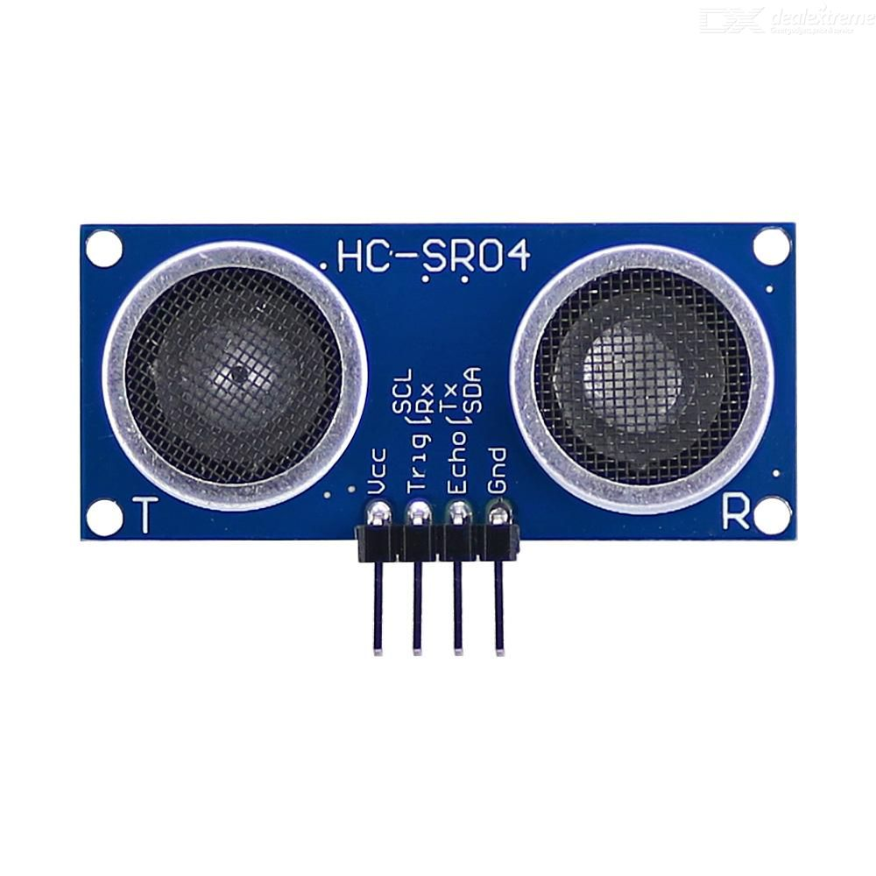
Fall Detection
//One ultrasonic sensor
#define BTRIGGER_PIN 10 // Arduino pin tied to trigger pin, Butttom sensor
#define B_ECHO_PIN 5// Echo pin for Bottom Ultrasonic sensor
#define MAX_DISTANCE 400//max distance 9in centimeters
NewPing B_sonar(BTRIGGER_PIN, B_ECHO_PIN, MAX_DISTANCE);
unsigned int B_uS = B_sonar.ping(); // Send ping, get ping time in microseconds (uS).
int B_distance = B_uS / US_ROUNDTRIP_CM;
// step/fall detection
if (B_distance > 50)
{
stop_delay();
}
We check if the distance from the sensor is greater than 50 centimeters and then if it is, call the stop_delay function which makes the car stop and then go backwards for 2 seconds

Slide 7
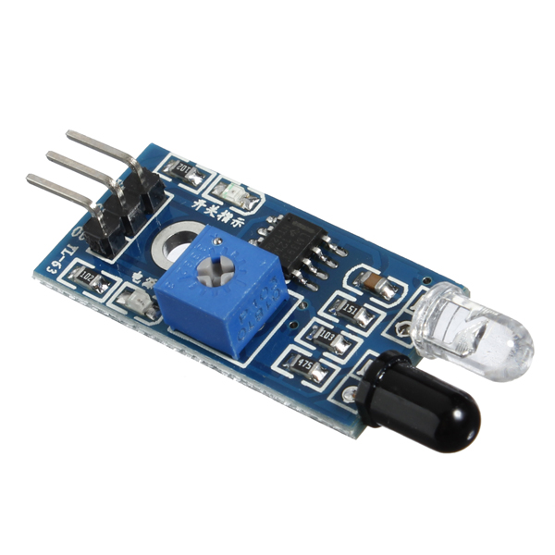
Interrupt
const int interrupt_pin =2;
//interrupt
void halt()
{
while(digitalRead(interrupt_pin) == LOW)
{
stop_delay();
}
}
void stop_delay()
{
// Serial.print("STOPED!!");
stopCar();
delay(1000);//delay one second
goBackward(backward, speedA);
delay(2000);
stopCar();
}
The halt function will detect if the interrupt pin goes to LOW and then call the stop_delay function which will cause the car to stop and then go a bit backwards.

Slide 8
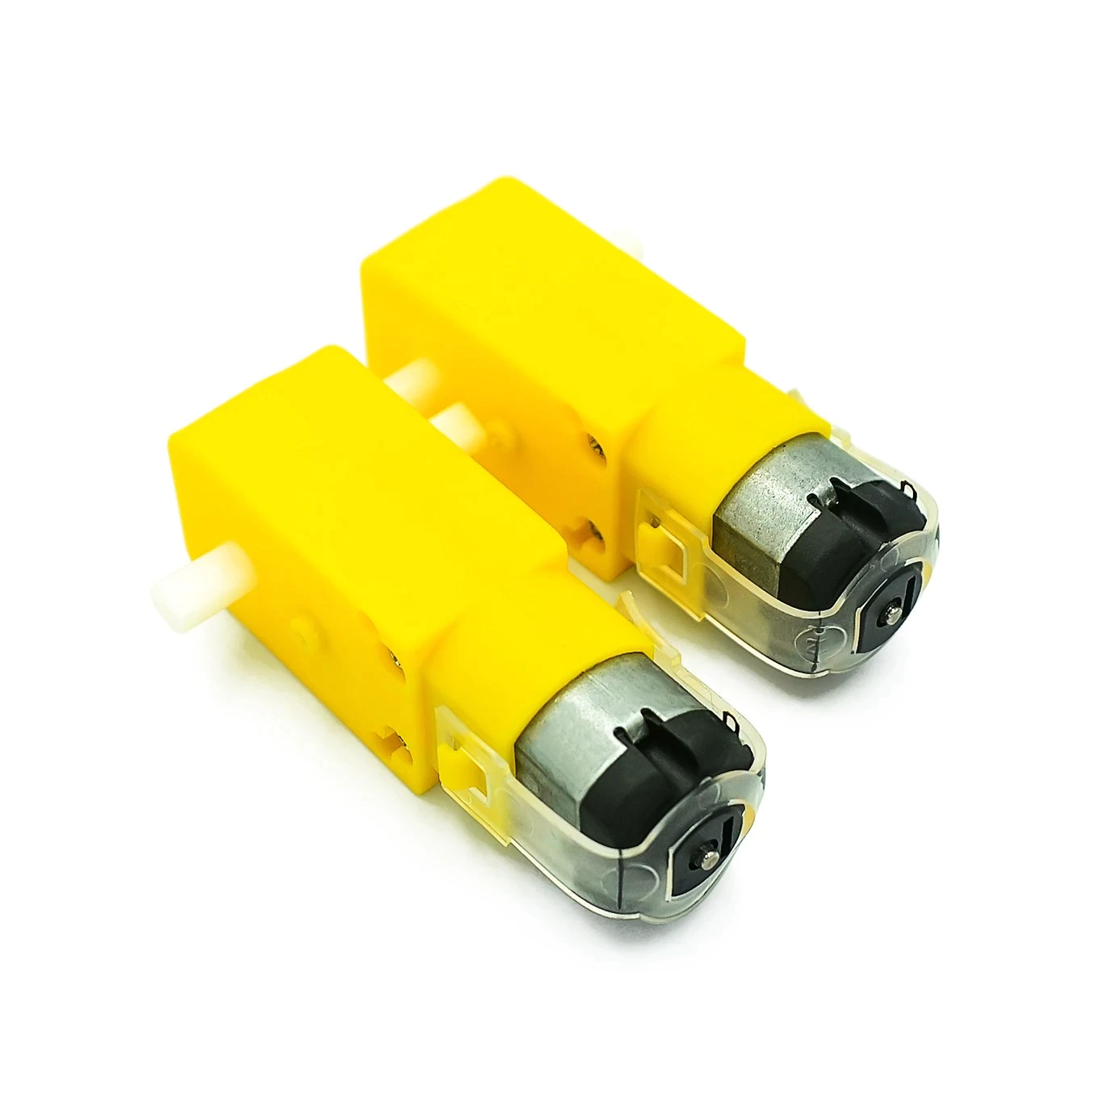
Motor Functions
void motionA(bool directionF, float speed1)
{
digitalWrite(Dir_A_Pin, directionF);
analogWrite(PWM_A_Pin, speed1);
}
void motionB(bool directionB, float speed2)
{
digitalWrite(Dir_B_Pin, directionB);
analogWrite(PWM_B_Pin, speed2);
}

Slide 9
Movement Functions
void goStraight(bool directionS, float speedS)
{
motionA(directionS, speedS);
motionB(directionS, speedS);
}
void goBackward(bool directionB, float speedB)
{
motionB(directionB, speedB);
motionA(directionB, speedB);
}
void turnL(bool directionL, float speedA, float speedB)
{
motionA(directionL, speedA);
motionB(directionL, (speedB*speedBL));
}
void turnR(bool directionR, float speedA, float speedB)
{
motionA(directionR, (speedA*speedAR));
motionB(directionR, speedB);
}
void stopCar()//Stops the car by setting the speed to zero using PWM for both motors
{
analogWrite(PWM_A_Pin, 0);
analogWrite(PWM_B_Pin, 0);
}
Standard movement functions to make the car go straight, backward, left, right and stop.

Slide 10
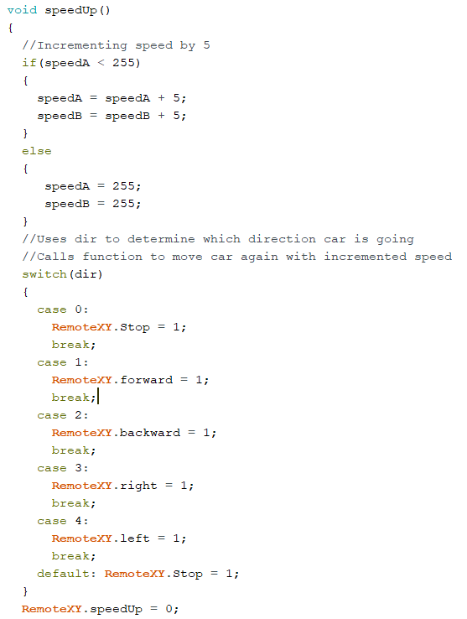
SpeedUp Function
Increment speed by 5 as long as the speed is less than than 255. Uses case statements to determine direction car is going in and call the function to make it move in that direction with new decremented speed.

Slide 11
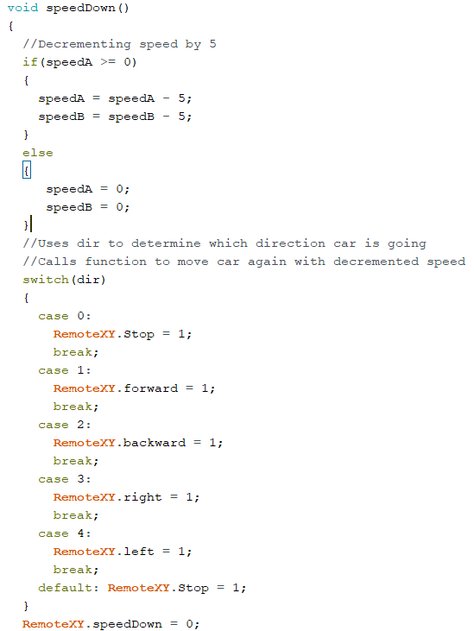
SpeedDown Function
Decrement speed by 5 as long as the speed is greater than zero. Uses case statements to determine direction car is going in and call the function to make it move in that direction with new decremented speed.

Slide 12
Questions ?

Slide 13
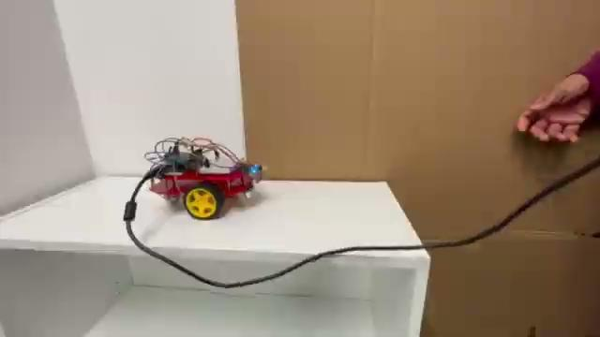
Step Detection

Slide 14
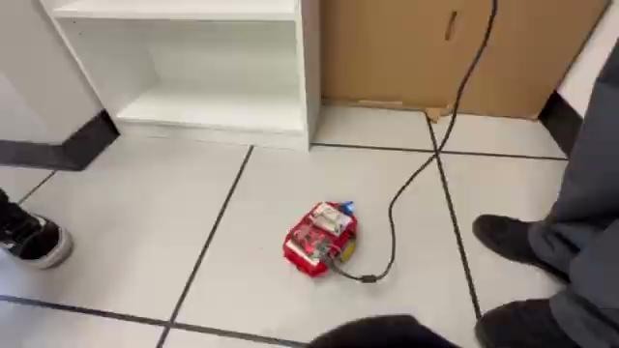
Crash Detection

